Slide 1
CO2301 - Games Development 1
Week 8
Depth-first search, Combinatorial Explosion, Heuristics, Hill-Climbing
Gareth Bellaby

Slide 2
Topic 1
Breadth-first search

Slide 3
Breadth-first
The breadth-first algorithm always expands those nodes that are closest to the start node.
On the grid we examine:
  the starting location,
  followed by locations 1 square away
  followed by locations 2 squares away
  and so on...

Slide 4
Implementing searches
All the search algorithms use lists.
The list is a list of coordinates. Each coordinate represents one location on the grid.
The algorithms use an Open List and a Closed List.
A coordinate is pushed onto a list or popped from a list.
The Open List is a First In, First Out list for the breadth-first search (FIFO).
A "rule" is the generation of a new coordinate from an existing coordinate. There are four rules: north, east, south and west.

Slide 5
Implementing searches
The x axis is horizontal. Movement right is positive x. The y axis is vertical.
North will is upwards.
North increments y by 1.
East increments x by 1.
South decrements y by 1.
West decrements x by 1.
For example, given (5, 5) four successor locations would be generated:
N (5, 6) E (6, 5) S (5, 4) W (4, 6)

Slide 6
The Breadth-first Algorithm
1) Create OpenList and ClosedList
2) Push the initial state (start) on to OpenList
3) Until a goal state is found or OpenList is empty do:
  (a) Remove (pop) the first element from OpenList and call it current.
  (b) If OpenList was empty, return failure and quit.
  (c) If current is the goal state, return success and quit
  (d) For each rule that can match current do:
    i) Apply the rule to generate a new state
    ii) If the new state has not already been visited, push the new state to end of OpenList.
  (d) Add current to ClosedList

Slide 7
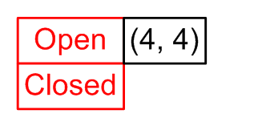
Worked example
Step 1. create Open and Closed.
Step 2. Start is (4, 4), push onto Open .
The "not visited" test will be implemented by comparing the coordinates to all of the coordinates currently on the Open list and the Closed List.

Slide 8
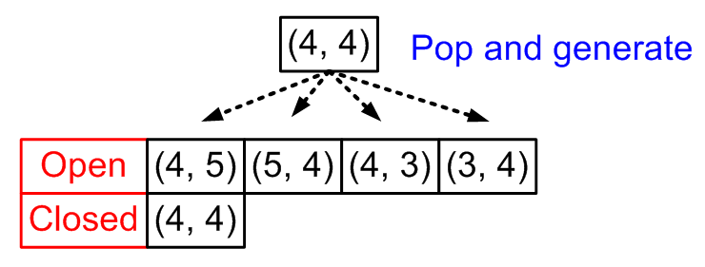
Worked example
Step 3.
Pop first element and call it current. Current is
(4, 4)
Apply the four rules.
  N generates (4, 5). Not visited so push (4, 5) onto Open.
  E generates (5, 4). Not visited so push (5, 4) onto Open.
  S generates (4, 3). Not visited so push (4, 3) onto Open.
  W generates (3, 4). Not visited so push (3, 4) onto Open.
Push current onto Closed.

Slide 9
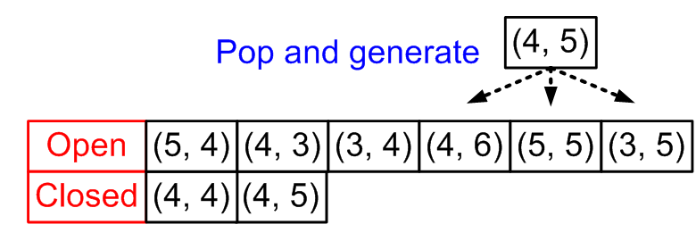
Worked example
Step 3 again.
Pop first - current is
(4, 5)
Apply the four rules.
  N generates (4, 6). Push (4, 6) onto Open.
  E generates (5, 5). Push (5, 5) onto Open.
  S generates (4, 4). Already visited so ignore.
  W generates (3, 5). Push (3, 5) onto Open.
Push current onto Closed.

Slide 10
Search Tree (Graph)
Trees are a basic structure within AI.
The nodes, linked together, form a tree-like structure.
The whole tree is described as the search state (or problem state)
A breadth-first search grows the bottom edge of the search tree.

Slide 11
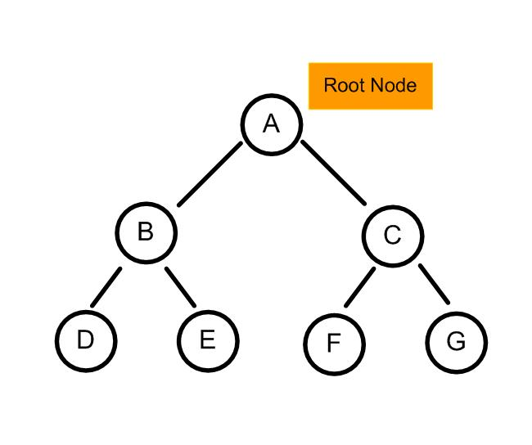
Search Tree (Graph)
b

Slide 12
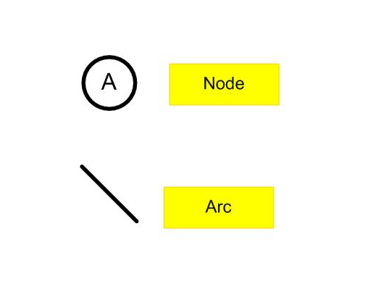
Trees
b

Slide 13
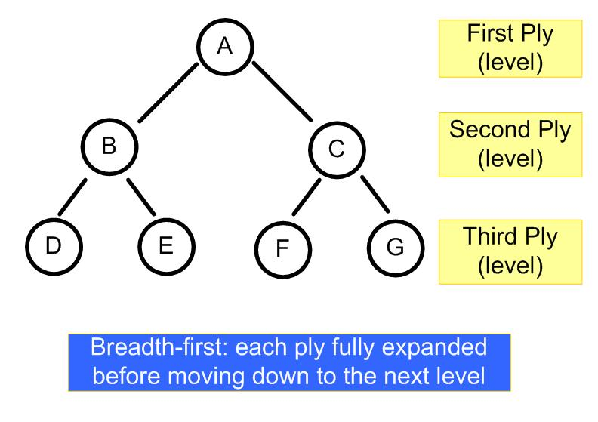
Breadth-first
b

Slide 14
Advantages & Disadvantages
Is the search guaranteed to find a solution?
  Yes
Is the search guaranteed to find an optimal solution?
  Yes
Is it efficient?
  No, because the whole of the problem space is searched. Breadth-first is an example of an exhaustive search.

Slide 15
Topic 2
Depth-first search

Slide 16
Depth-first
Whenever given a choice of extending the search from several nodes, the depth-first algorithm always chooses the deepest one.
Only one path is followed at a time.

Slide 17
Depth-first
The depth-first algorithm expands a single node which is farthest from the start node.
On the grid we examine:
the starting location,
followed by one location connected to the start
followed by a one location connected to this new location
and so on...

Slide 18
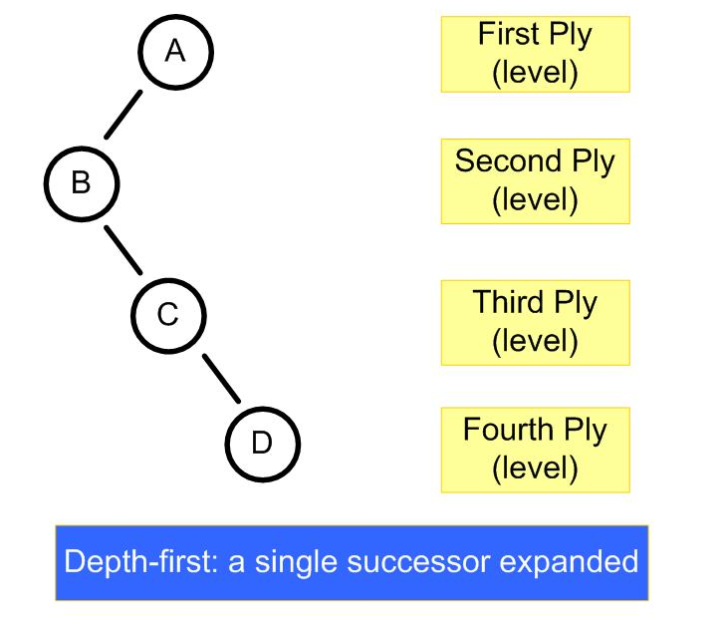
Depth-first

Slide 19
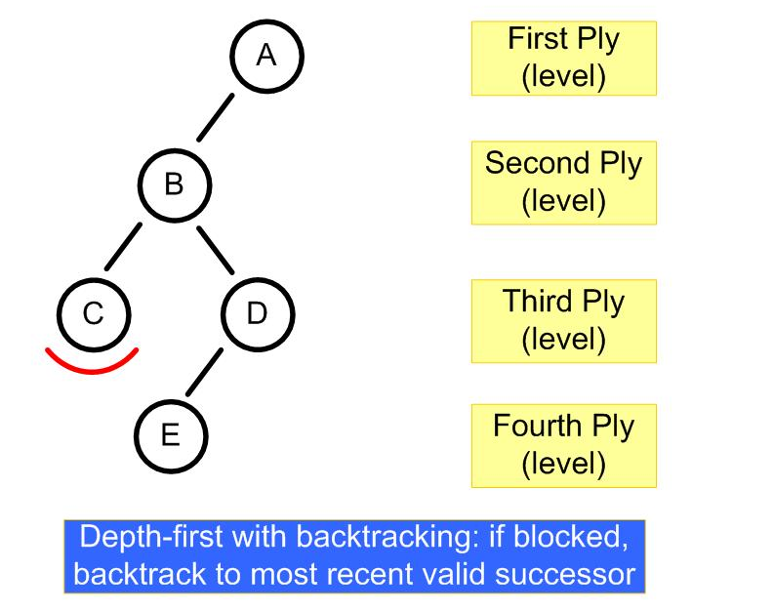
Depth-first with backtracking

Slide 20
Advantages & Disadvantages
Is the search guaranteed to find a solution?
    - Yes but only so long as backtracking is used and a limit is applied
Is the search guaranteed to find an optimal solution?
    - No
Is it efficient?
    - Depends. Typically it will be, but it can take longer than a breadth-first search.
We want a depth-first search that can be directed to its goal.

Slide 21
Topic 3
Combinatorial Explosion

Slide 22
How big could the tree get?
Consider a breadth-first search
1 + 4
1 + 4 + 8
1 + 4 + 8 + 12

Slide 23
What's the pattern?
1
1 + 4
1 + 4 + 8
1 + 4 + 8 + 12
1 + 4 + 8 + 12 + 16...
1
1 + (1 * 4)
1 + (1 * 4) + (2 * 4)
1 + (1 * 4) + (2 * 4) + (3 * 4)
1 + (1 * 4) + (2 * 4) + (3 * 4) + (4 * 4)...
1
1 + (1 * 4)
1 + (3 * 4)
1 + (6 * 4)
1 + (10 * 4) ...

Slide 24
What's the pattern?
1, 3, 6, 10 is a number sequence called triangular numbers.
The equation for the triangular number sequence is
(n² + n) / 2
The On-Line Encyclopedia of Integer Sequences
http://www.research.att.com/~njas/sequences/
1 + ( 4 * (n² + n) / 2 )
1 + ( 2 * ( n² + n) )

Slide 25
Combinatorial Explosion
So a 101 by 101 search (ignoring edges) will be
1 + ( 2 * ( 101² + 101) ) = 20,605
A more sophisticated representation of the map would generate an even larger search space.
Combinatorial explosion suggests that we need to consider non-exhaustive search techniques.
Depth-first could get lucky, but may be better to use a directed search.

Slide 26
Pruning
Pruning means the removal of branches from the tree.
Hopefully these are unnecessary branches...
The removal of repetition is an example of pruning.
Other algorithms help us prune the tree in various ways.

Slide 27
Topic 4
Heuristic

Slide 28
Heuristic search
Breadth-first search and Depth-first search easily become unwieldy. The alternative is to direct the search using heuristics.
Heuristic: a rule of thumb.
No formal way to discover which heuristic to use.
No formal way to prove whether a heuristic is useful, or to measure how good it is.

Slide 29
Heuristic search
Use common sense, experience and testing.
Not guaranteed to find the best solution, or even any solution, but can overcome combinatorial explosion. It’s also the case that:
  the best solution is not always required
  understanding heuristics may lead to a better understanding of the problem.

Slide 30
Heuristic - Manhattan Distance
It is possible in some cases to devise the optimal heuristic.
For our scenario of a square grid with only horizontal and vertical movement the best heuristic is the Manhattan Distance.
The Manhattan Distance is the absolute distance from a location to the goal, measured square by square.
It can be proven that this is the optimal heuristic if the cost of the squares is 1: it neither overestimates nor underestimates the distance left to travel.

Slide 31
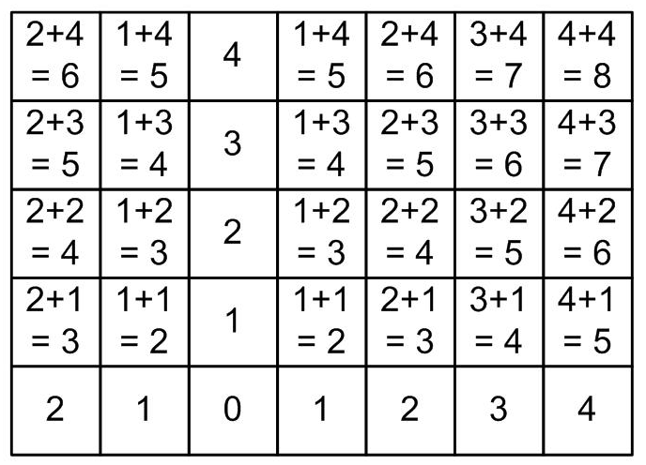
Manhattan Distance
The absolute distance from a location to the goal, measured square by square

Slide 32
Topic 5
Hill-climbing

Slide 33
Hill Climbing
Variant on depth-first search.
Includes help for the generator to decide which direction to move. Uses a heuristic function that provides an estimate of how close a given state is to a goal state.
This appears to be a sensible notion:
  imagine climbing to the top of a hill - you would choose paths which lead upwards
  Imagine walking in a strange town - you could choose a visible landmark and try to walk towards it

Slide 34
Search mechanisms
Need a heuristic. Has to be a numerical value (or how else could a comparison be done?)
Need an evaluation function which generates a numerical value.
The metaphor used for the value derived from the evaluation function is height: this is why it is called hill-climbing.
For example, imagine a scenario where we just want to find the best path to a given location: use the Manhattan Distance to generate a score for each square.
In this case the best successor will be the square with the shortest apparent distance to the goal.

Slide 35
Hill Climbing Algorithm
1) Create OpenList, ClosedList and TmpList
2) Push the initial state (start) on to OpenList
3) Until a goal state is found or OpenList is empty do:
  (a) Remove (pop) the first element from OpenList and call it 'current'.
  (b) If OpenList was empty, return failure and quit.
  (c) If 'current' is the goal state, return success and quit
  (d) For each rule that can match 'current' do:
    i) Apply the rule to generate a new state and calculate its heuristic value
    ii) If the new state has not already been visited, add the new state to TmpList.
  (e) Sort TmpList according to the heuristic values of the elements.
  (f) Add TmpList to the front of OpenList.
  (e) Add 'current' to ClosedList.

Slide 36
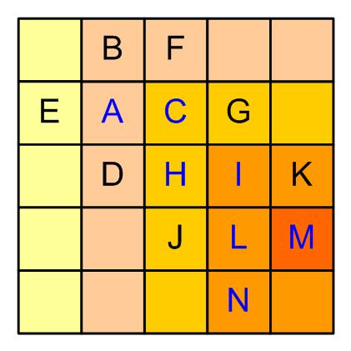
Hill Climbing

Slide 37
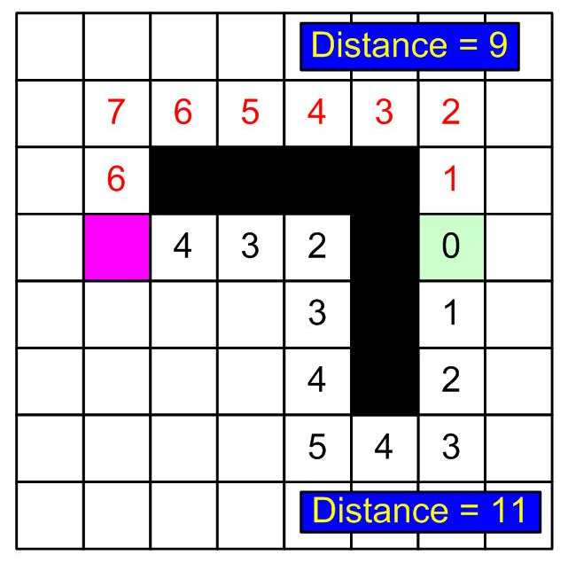
Hill Climbing - Problems
The algorithm will choose the black route.
But the optimal path is actually the red route.

Slide 38
Problems with Hill Climbing
One problem is that Hill Climbing is local rather than global (i.e. only looks at adjacent space), e.g. foothills are local maxima. Three phenomena:
  Foothills – up, but not the top
  Plateaus – all standard moves make no change
  Ridges – the only change is down
Not always very effective.
Backtracking is not guaranteed to work.

Slide 39
Problems with Hill Climbing
Problems can be reduced by:
  backtracking (but note point 3 above)
  making a big jump in one direction
  applying several rules
  introducing randomness
But still not as good as Dijkstra's algorithm or A*.

